Slide 1
CS1120
Introduction to
Windows Forms Applications
Many slides modified or added by Prof. L. Lilien (even many without an explicit message).
Slides added by L.Lilien are © 2006-2010 Leszek T. Lilien.
Permission to use for non-commercial purposes slides added by L.Lilien’ will be gladly granted upon a written (e.g., emailed) request.

Slide 2
The following slides are courtesy of
Ms. Stephany Coffman-Wolph
(2/9/09)
NOTE:
Formatting changed, some other changes made by L. Lilien

Slide 3
1. GUI
Introduction
GUI = Graphical User Interface
Allows the user to interact visually with a program
This is the “make it pretty” part

Slide 4
Building GUI
GUI's are built from GUI controls
Also known as components or widgets
They are objects that can:
  Display information on the screen, or
  Enable users to interact with an application via the mouse, keyboard or other form of input
Examples - commonly used types of GUI controls
  Label, TextBox, Button, CheckBox ComboBox, ListBox

Slide 5
GUI in MS Visual Studio for C#: Windows Forms
Windows Forms (or “Forms”) - used to create GUI's for C# programs
  Create graphical elements that appear on the desktop (dialog, window, etc.)

Slide 6
Components for GUI
For future use:
Component is an instance of a class that implements the IComponent interface
We’ll cover interfaces later – they define what operations can happen but not how they are performed
GUI controls are components
Some have graphical representation
  E.g., Form, Button, Label
Others do not
  E.g., Timer

Slide 7
2. Using Toolbox in Visual Studio to Create GUIs
The controls and components of C# are found in the C# Toolbox in Visual Studio
  Organized by functionality
To open Toolbox (takes time!):
  Menu/Item: View>>Toolbox:
To add a component to a Form:
  Select that component in Toolbox
  Drag it onto the Form

Slide 8
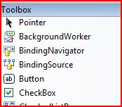
Using the Toolbox - Basics
(After you open it with: View>>Toolbox), the toolbox is located on the left-hand side of the VS screen
Click on the control you want to add and drag it to the form

Slide 9
3. Properties and Methods for GUI Controls
Each control has properties (and some methods)
  Example properties:
    Enable
    Font
    Text
    Visible
  Example methods:
    Hide
    Select
    Show

Slide 10
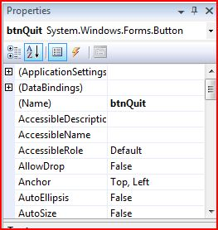
Editing the Properties
Click on the control for which you want to change the properties
  E.g., click on form, button, label, etc.
You can make these changes in the Properties window located on the bottom right

Slide 11
4. Naming Controls
In C#, default names for controls/components are:
  button1, label1, textbox1, etc.
    not very descriptive (“generic”)
Use better, descriptive names
  Names to have meanings that make sense

Slide 12
Conventions for Naming Controls - Start the control name with...
Control
  Button
  TextBox
  ListBox
  Label
  SaveFileDialog
Begin name with
  btn
  txt
  lbox
  lbl
  sfd
Examples of Naming Controls
  A button used to calculate a total:
    btnCalcTotal
  A textbox that allows a user to enter her name:
    txtEnterName

Slide 13
The following slides are based on textbook slides
NOTE:
Formatting changed, some other changes made by L. Lilien

Slide 14
5. In-class Exercise:
Using Visual Programming to
Create a Simple Program that Displays Text and an Image
This section based on textbook slides for Section 2.6 (p. 40-ed.4; p.51-ed.3)
We will follow (most of) the steps shown on the following slides for this lecture section

Slide 15
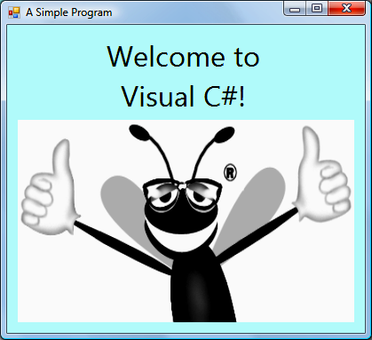
Using Visual Programming to Create a Simple Program that Displays Text and an Image (Cont.)
This program just displays such window:
Controls that will be used for this programs;
  A Label — contains the descriptive text
  A PictureBox — displays the image
    Such as the Deitel bug mascot
Label control
PictureBox control
Fig. 2.25 | Output of the simple program.

Slide 16
Using Visual Programming to
Create a Simple Program that Displays Text and an Image (Cont.)
Start your Visual Studio.

Slide 17
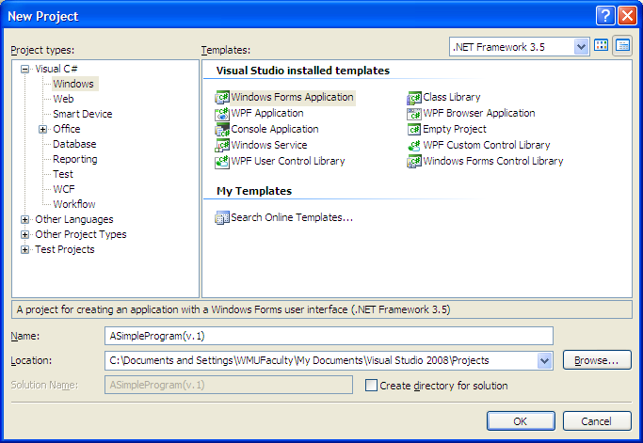
Using Visual Programming to Create … (Cont.)
Select File > New Project… and select Windows Forms Application template (Fig. 2.27)
Name the project ASimpleProgram
Click Browse to select directory for saving this project.
Type the project name
Template types
Fig. 2.27-ed.3 | New Project dialog (updated by LL).

Slide 18
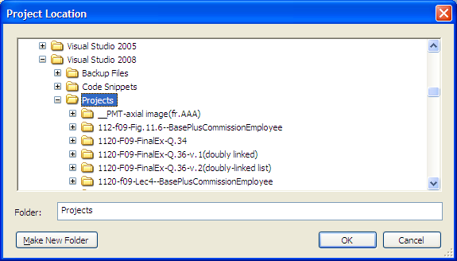
Using Visual Programming to
Create a Simple Program that …(Cont.)
The following Project Location dialog shows up (Fig. 2.28).
Fig. 2.28-ed.3 | Project Location dialog (updated by LL).
Select (or create) folder for the project.
Click OK when done.

Slide 19
Using Visual Programming to
Create a Simple Program that … (Cont.)
Click OK again when the New Project dialog shows up
Type the project name
Template types
Fig. 2.27-ed.3 | New Project dialog (updated by LL).

Slide 20
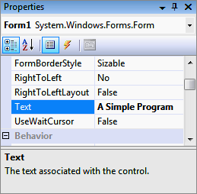
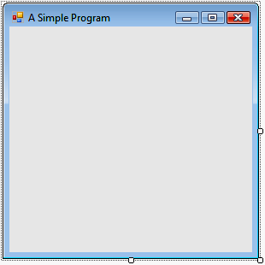
Using Visual Programming to Create … (Cont.)
Right-click anywhere on the Form to display the Form’s properties in the Properties window.
Click in the textbox to the right of the Text property box and type “A Simple Program” (Fig. 2.30)
Press Enter
  See the Form’s title
  bar updated immedia-
  tely (Fig. 2.31-ed.3).
Name and type of control
Fig. 2.30-ed.3 | Setting the Form’s Text property in the Properties window.
Selected property
Property value
Property description
Title bar
Fig. | Form with the updated Text property.

Slide 21
Using Visual Programming to Create … (Cont.)
Resize the Form by clicking and dragging one of the enabled sizing handles (Fig. 2.31).
Enabled sizing
handles
Fig. 2.31 | Form with enabled sizing handles.

Slide 22
Using Visual Programming to
Create a Simple Program that … (Cont.)
Make the Form larger
  Select the bottom-right sizing handle and drag it down and to the right to (Fig. 2.32).
  Watch that the Size property changes after dragging
  Note: You can also resize a Form by typing new value for the Size property.
Fig. 2.32 | Resized Form.

Slide 23
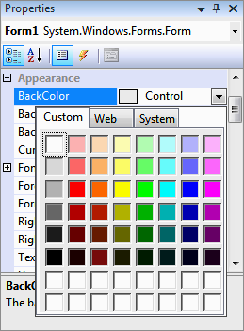
Using Visual Programming to Create a Simple Program Program that …(Cont.)
In the Properties window, click BackColor
  A down-arrow button to appears to the right of BackColor(Fig. 2.33).
Click on the down-arrow button
  The arrow displays for Custom, Web and System tabs
    For Custom, Web and System colors
Click the Custom tab
  Displays the palette
  Select light blue (in the top row).
Current color
Custom palette
Down-arrow button
Light blue
Fig. 2.33 | Changing the Form’s BackColor property.

Slide 24
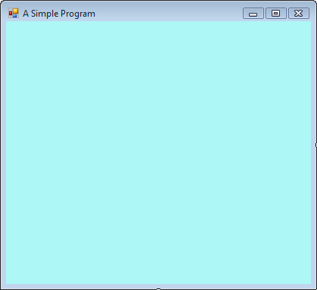
Using Visual Programming to
Create a Simple Program that Displays Text and an Image (Cont.)
Once you select the color, the Form’s background changes to light blue (Fig. 2.34).
New background color
Fig. 2.34-ed.3 | Form with new BackColor property applied.

Slide 25
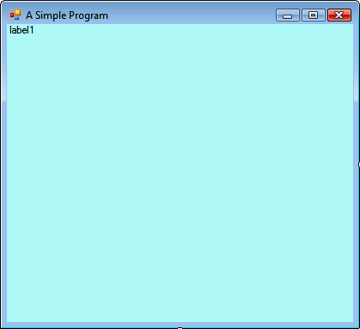
Using Visual Programming to
Create a Simple Program that Displays Text and an Image (Cont.)
If the toolbox is not open, open it
  View>>Toolbox (might be slooow, be patient)
Add a Label (will contain “Welcome to Visual C#!”)
  Find and drag the Label control from the Toolbox to the Form (Fig. 2.35)
  OR:
  Double click the
  Label control
  in the Toolbox
Label control
Fig. 2.35 | Adding a Label to the Form.

Slide 26
Using Visual Programming to Create … (Cont.)
Click on the Label to make its properties appear in the Properties window (Fig. 2.36).
Click on the Label’s Text property, then on the down-arrow that shows up.
Replace the text label1 with the text Welcome to Visual C#!
  See new text showing up in the label

Slide 27
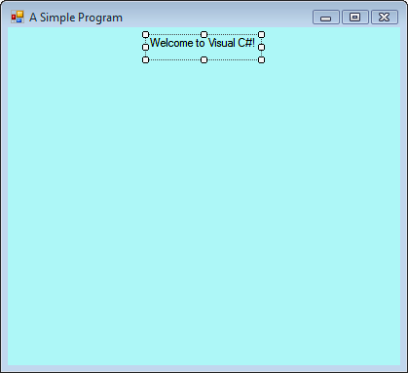
Using Visual Programming to Create … (Cont.)
Move the Label by dragging it
  OR: by selecting it, and then using the left and right arrow keys
Select the Label and center it
  Format>>Center in Form >> Horizontally
Now the form looks like this:
Sizing
handles
Label centered with
updated Text property
Fig. 2.37 | GUI after the Form and Label have been customized.

Slide 28
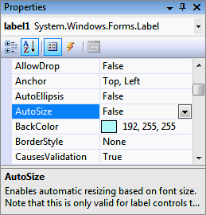
Using Visual Programming to Create … (Cont.)
Set the AutoSize property to False
  If the AutoSize property is set to True, it automatically resizes the Label to fit its text
    We will change it, and we don’t want automatic resizing
AutoSize
property
Fig. 2.36 | Changing the label1’s AutoSize property to False.

Slide 29
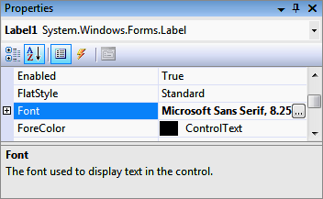
Using Visual Programming to Create … (Cont.)
Change the font of the Label’s text
  Click on the Font property (Fig. 2.38).
  The ellipsis button appears
  Click on the ellipsis button
    The Font dialog appears (next slide)
Ellipsis button
Fig. 2.38 | Properties window displaying the Label’s properties.

Slide 30
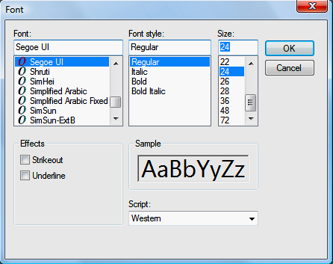
Using Visual Programming to
Create a Simple Program that … (Cont.)
The Font dialog (Fig. 2.39) allows you to select the font name, style and size.
  Under Font, select Segoe UI.
  Under Size, select 24 points
  Click OK.
Resize the Label if it’s not large enough to hold the text.
Current font
Font sample
Fig. 2.39 | Font dialog for selecting fonts, styles and sizes.

Slide 31
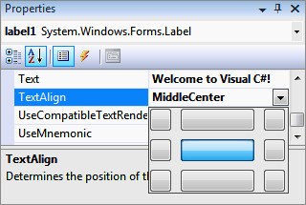
Using Visual Programming to
Create a Simple Program that Displays Text and an Image (Cont.)
Select the Label’s TextAlign property (Fig. 2.40)
  Set it to MiddleCenter
Text alignment
options
MiddleCenter
alignment option
Fig. 2.40 | Centering the Label’s text.

Slide 32
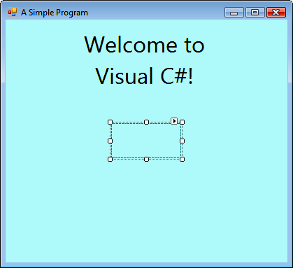
Using Visual Programming to Create …(Cont.)
Make sure that text in the label is in two rows (see Fig. below).
  If not, adjust label size to have text in 2 rows as shown
Drag PictureBox from the Toolbox to the Form (Fig. 2.41).
Updated
Label
PictureBox
Fig. 2.41 | Inserting and aligning a PictureBox.

Slide 33
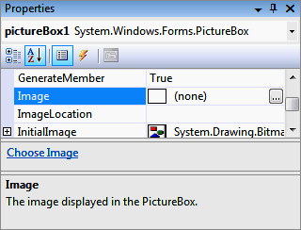
Using Visual Programming to
Create a Simple Program that Displays Text and an Image (Cont.)
Click the PictureBox to display its properties in the Properties window (Fig. 2.42).
The Image property displays a preview of the image, if one exists.
Image property value
(no image selected)
Fig. 2.42 | Image property of the PictureBox.

Slide 34
Using Visual Programming to Create … (Cont.)
From the instructor’s web page, get the file with the image of the happy bug
Lect.5b--bug Fig 2.44 for Sect.2.6__ bug.PNG file
.
Save it (e.g., on the desktop).

Slide 35
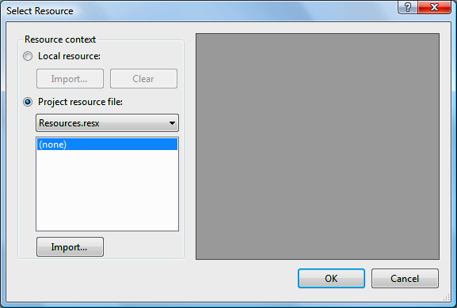
Using Visual Programming to Create … (Cont.)
Click the Image property.
  The ellipsis button appears
Click the ellipsis button
  The Select Resource dialog appears (Fig. 2.43)
Select Local resource radio button
Click the Import… button
Fig. 2.43 | Select Resource dialog to select an image for the PictureBox.

Slide 36
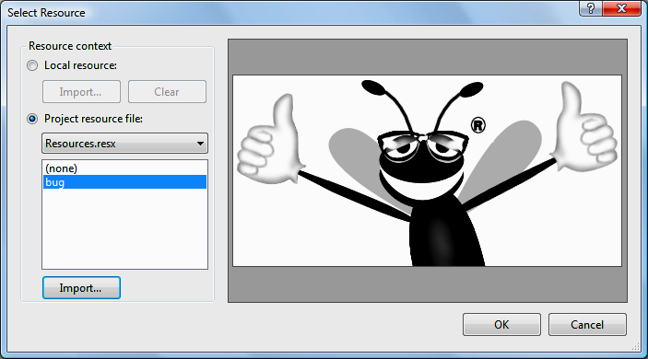
Using Visual Programming to Create … (Cont.)
In the dialog that appears, locate the image file, select it and click Open ( or OK).
The image should show up in the Select Resource dialog (Fig. 2.44).
Click OK
  The image (or its part) shows up in your program window.
Image file name
Fig. 2.44 | Select Resource dialog displaying a preview of selected image.

Slide 37
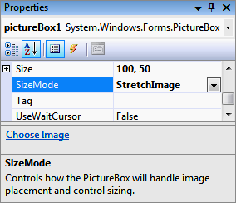
Using Visual Programming to Create … (Cont.)
Size the image to the PictureBox:
  Click on the SizeMode property
    Down-arrow shows up to the right
  Use the down-arrow to select StretchImage (Fig. 2.45).
SizeMode
property
SizeMode
property set to
StretchImage
Fig. 2.45 | Scaling an image to the size of the PictureBox.

Slide 38
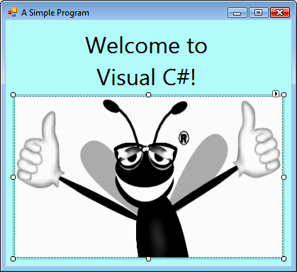
Using Visual Programming to Create … (Cont.)
Adjust the size of the image to visually match the following figure
  Use the sizing handles of the PictureBox
Newly
inserted
image
Fig. 2.46 | PictureBox displaying an image.

Slide 39
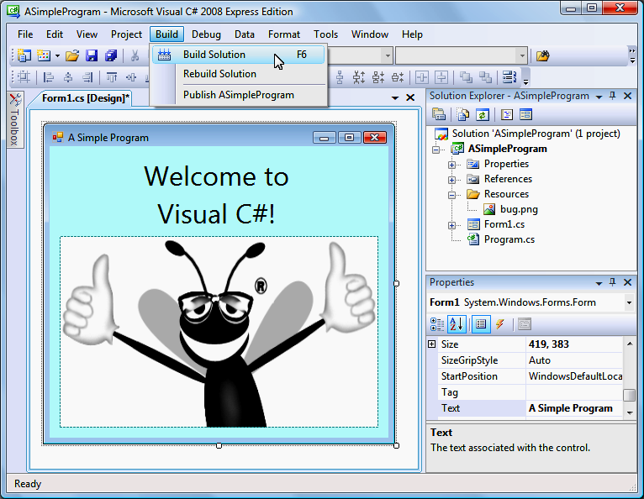
Using Visual Programming to Create … (Cont.)
We have created form not by programming, but by drawing it
  But code exists!
  Code has been generated for you automatically
How to see the code generated for the form you drew?
  Go to Solution Explorer window
  Click on small triangle next
  to Form1.cs
  Double-click on Form1.Designer.cs
    Detailed code for Form1 shows up
Slide added by L. Lilien

Slide 40
Using Visual Programming to Create … (Cont.)
How to see the rest of the code generated for the form you drew?
  You are in the Design View -------->
    It is the Form1.cs [Design] window
    You used it to draw the form
  Switch from the Design View to
  the Code View as follows:
    View >> Code
    (or use F7)
    You will be shown the Form1.cs window (next slide)
      Not the Form1.cs [Design] window
Slide added by L. Lilien

Slide 41
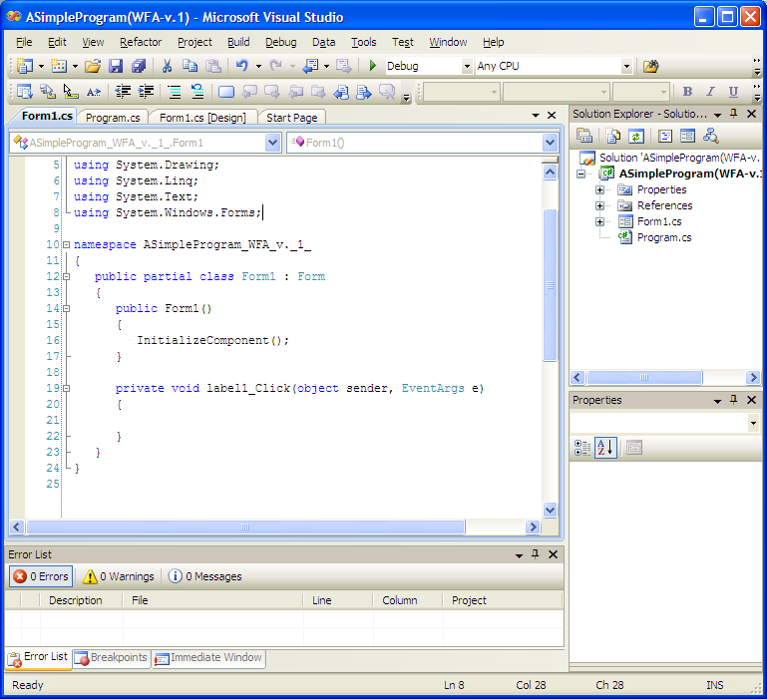
Using Visual Programming to Create …(Cont.)
You are now in the Code View -------->
  It is the Form1.cs window
  It shows the rest of the code
  automatically generated for Form1
You can switch from Code View to Design(er) View as follows:
  View >> Designer
  (or use SHIFT+F7)
  Slide added by L. Lilien

Slide 42
Using Visual Programming to Create … (Cont.)
Select File >> Save All to save the entire solution
Select Build>>Build Solution
Build menu

Slide 43
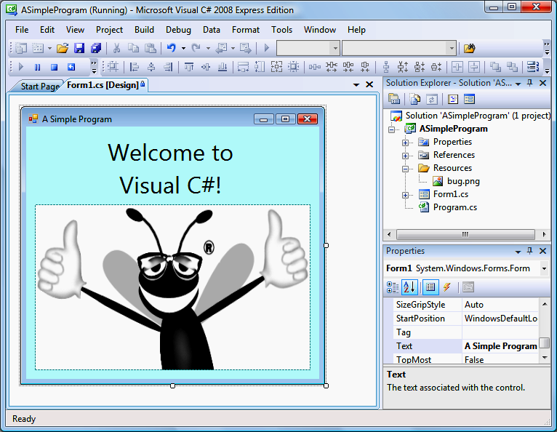
Using Visual Programming to Create … (Cont.)
Select Debug >> Start Debugging to compile and execute the program (Fig. 2.48).
IDE displays text Running, which
signifies that the program is executing
Close box
Form
Running program
Fig. 2.48 | IDE in run mode, with the running program in the foreground.

Slide 44
The following slides are again courtesy of
Ms. Stephany Coffman-Wolph
(2/9/09)
NOTE:
Formatting changed, some other changes made by L. Lilien

Slide 45
6. Event Handling
When a user interacts with a form, this causes an event to occur
  E.g., clicking a button, typing in a textbox, etc. are events
Events signal that certain code should be run
  To perform some actions
Event Handler = method that runs after an event occurs
Event Handling = the overall process of responding to events
All GUI controls have associated events

Slide 46
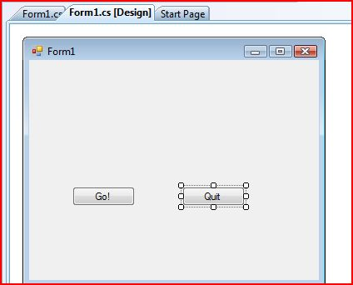
Event Handler for
Clicking a Button
The following code is for a button named btnQuit
  Function: When the button is clicked, the form closes
  private void btnQuit_Click(object sender, EventArgs e)
  {
  this.Close();
  }

Slide 47
How to write code for an event...
Suppose that you are working on
the design of Form1 (see Fig)
  You are in the Design View
You have edited form properties
Double-click on the Quit button
  You will be switched to the Code View
  The following method appears in the code generated for the form:
    private void btnQuit_Click(object sender, EventArgs e)
    {
    code to be written by you can be added here (to be shown later)
    }

Slide 48
7. Fun with Textboxes
A textbox is an area in which text can be displayed or users can type in text
A password textbox is a textbox that hides the information entered by the user (masking it with a black dot)
Password textbox is a textbox in which the property UseSystemPasswordChar is set to True
  (False is the default setting)

Slide 49
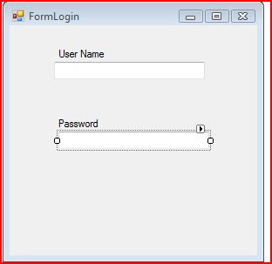
Example: Log-in Screen
Drag two Label controls from Toolbox onto the form
  Use the properties to change the default names to User Name and Password
Drag two Textbox controls onto the form

Slide 50
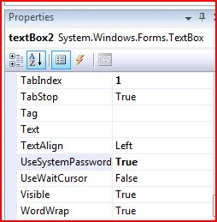
Example: Log-in Screen (Cont.)
Making the Textbox for Typing in Passwords
Click on the second of the two textboxes
Find the UseSystemPasswordChar property in Properties for the 2nd textbox and change to True
  NOTE: In the figure, “Char” is truncated from the property name “UseSystemPasswordChar “due to small window size

Slide 51
How to Get Info From/ToTextbox
Suppose that your textbox is named txtUserName
  To get information typed into a textbox by a user , use the following code:
    string userName = txtUserName.Text;
  To display “Hello!” in the textbox, use:
    txtUserName.Text = “Hello!”;
  To empty the textbox, use:
    txtUserName.Text = “”;

Slide 52
8. Using Multiple Forms
Can a program have multiple forms?
  Yes!
How is this accomplished?
  By passing the form reference during a call to the constructor...
    Example:
    public FormLogin(Form1 f)
    (used in Line 16 on Slide +3 - i.e. 3 pages forward)

Slide 53
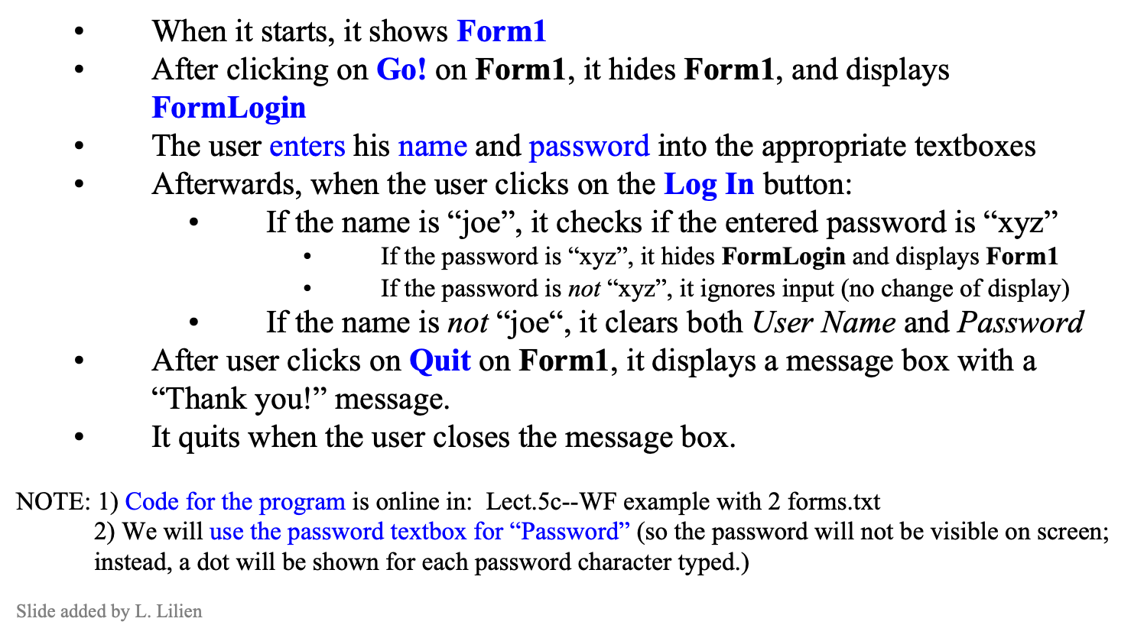
Example: Using Multiple Forms
Write a program that uses the 2 forms
shown to the right, and performs the
following actions:
Log In

Slide 54
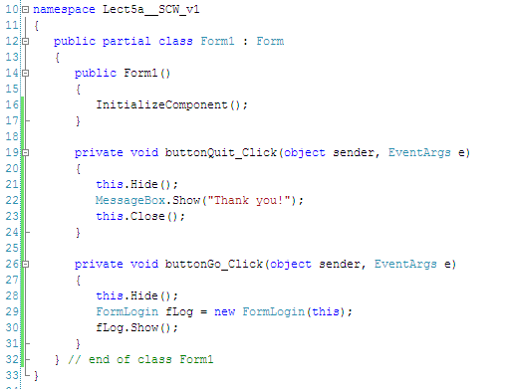
Code for the Form1 form
RECALL:
After user clicks on Quit on Form1, the program:
  - Hides Form1
  - Displays a message box with a “Thank you!” message.
  - Quits (closes) after the user closes the message box.
After clicking on Go! on Form1, the program:
  - Hides Form1
  - Creates FormLogin
  - Displays FormLogin
Slide modified by L. Lilien

Slide 55
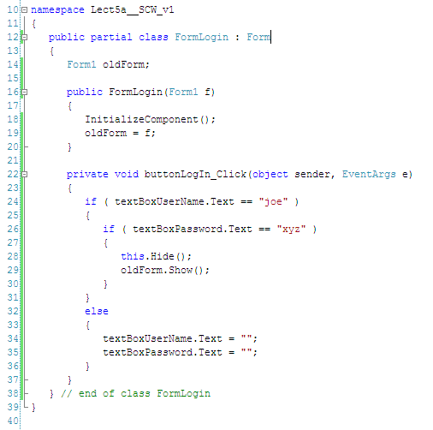
Code for the FormLogin form
RECALL:
The user enters his name and password into the appropriate textboxes on FormLogin
Afterwards, when the user clicks on the Log In button:
  - If the name is “joe”, it checks if the entered password is “xyz”
    - If the password is “xyz”, it hides FormLogin and displays Form1
    - Else (if the password is not “xyz”), it ignores input (no change of display)
  - Else (if the name is not “joe“), it clears both User Name and Password textboxes.
Slide modified by L. Lilien

Slide 56
Running the 2-form WFA Example in 27 easy steps
IMPORTANT Follow this procedure exactly. Changing the order of copying code into the project files might result in errors.
0) Start the MS Visual Studio, and open a new WFA project.
1) Open the Program.cs tab. (If the tab is not shown yet, go to the Solution Explorer window, and double-click on Program.cs.) A window (and a tab) for Program.cs shows up.
2) In Line 6, change namespace name to: cs1120_WF2_2_forms___v1
3) Open the Form1.cs [Design] window. (If the Form1.cs [Design] tab is not shown yet, go to the Solution Explorer window, and double-click on Form1.cs.) See that the windows shows a default form only.
4) In the Solution Explorer window, click on + next to Form1.cs. Form1.Designer.cs name shows up.
  Note: Remember that Form1.cs [Design] (the Design View) and the Form1.Designer.cs are two different windows/views!
5) Double-click on Form1.Designer.cs. A window (and a tab) for Form1.Designer.cs shows up.
6) Erase contents of the Form1.Designer.cs window.
7) Copy the code for Form1.Designer.cs (only!) from the provided file (which includes all code for this example into the Form1.Designer.cs window.
Look at and try to understand code fragments defining (from the bottom up) FormLogin, buttonQuit, and buttonGo.
8) Go to the Form1.cs [Design] window. See that it includes now a form with two buttons: Go! and Quit. (So the code you pasted in the preceding step changed the default form to this form.)
9) Go to the Solution Explorer window, and right-click on the name of your project in bold (this should be the second line from the top). A pop-up menu shows up.

Slide 57
Running the 2-form WFA Example … (Cont.)
10) Select Add in the menu. Another pop-up menu shows up. Select New Item... in the menu. A pop-up window shows up. In the left pane, select Windows Forms under Categories. In the right pane, select Windows Forms.
Click on the Add button. A line with text Form2.cs appears in the Solutions Explorer.
11) See the Form2.cs [Design] window. (If the Form2.cs [Design] tab is not shown yet, go to the Solution Explorer window, and double-click on Form2.cs.) See that the windows shows a default form only.
12) In the Solution Explorer window, click on + next to Form2.cs. Form2.Designer.cs name shows up.
Note: Remember that Form2.cs [Design] (the Design View) and the Form2.Designer.cs are two different windows/views!
13) Double-click on Form2.Designer.cs. A window (and a tab) for Form2.Designer.cs shows up.
14) Erase contents of the Form2.Designer.cs window.
15) Copy the code for Form2.Designer.cs (only!) from the provided file (which includes all code for "WF example with 2 forms") into the Form2.Designer.cs window.
Look at and try to understand code fragments defining (from the bottom up) FormLogin, buttonLogIn, textBoxPassword, textBoxUserName, labelPassword, and labelUserName.
16) Go to the Form2.cs [Design] window.See that it includes now a form with one button (“Log In”), and two textboxes with their labels (for user name and password). (So the code you pasted in the preceding step above changed the default form to this form.)
17) Change form name from Form2 to FormLogin by changing Text property in the properties
window. (But do not change the name of the Form2.cs file.)

Slide 58
Running the 2-form WFA Example … (Cont.)
18) Go to the Form1.cs [Design] window. Change view for Form1 from the current Design View to the Code View. (To do it, e.g., click on the Form1.cs [Design] window, then press F7.)
The Code View for Form1, that is the window Form1.cs, shows up.
19) Erase contents of the Form1.cs window.
20) Copy the code for Form1.cs (only!) from the provided file (which includes all code for "WF example with 2 forms") into the Form1.cs window.
21) Go to the Form2.cs [Design] window. Change view for Form2 from the current Design View to the Code view. (To do it, e.g., click on the Form2.cs [Design] window, then press F7.)
The Code View for Form2, that is the window Form2.cs, shows up.
22) Erase contents of the Form2.cs window.
23) Copy the code for Form2.cs (only!) from the provided file (which includes all code for "WF example with 2 forms") into the Form2.cs window.
24) Save project code with File>>Save All.
25) Select Build>>Build Solution. You should get the "Build succeeded" message. (If not, fix bugs, or repeat all steps, starting with a new project.)
26) Run with Debug>>Start Without Debugging.
27) Play with the program: try various combinations of input to see all program behavior.
Have fun!

Slide 59
8. In-class Self-evaluation Exercise
Consider the program implementing the Point3-Circle4 hierarchy from Lecture 4, defined in the following files in the _downloads folder:
Lect.4b5--Point3.txt Lect.4b6--Circle4.txt Lect.4b7--CircleTest4(Point3+Circle4Test).txt
The original program accepts no user’s input, just prints hard-coded data.
Modify it so that it uses as follows 3 windows forms designed by you for its user’s input :
Create a form FormManageShape
It should have 2 buttons Create point and Create circle. Clicking on the Create point buttons hides the FormManageShape and displays FormPoint. The other button behaves analogously.
Create a form FormPoint with two textboxes “X Coordinate” and “Y Coordinate” and two buttons: “Display Point Data” and “Back to Shape Manager.” The former will display point coordinates (with proper labels) using MessageBox.Show(…). The function of the latter is clear from its name.
Create a form FormCircle with three textboxes “X Coordinate”, “Y Coordinate” and “Radius,” and two buttons: “Display Circle Data” and “Back to Shape Manager.” The former will display circle coordinates and radius (with proper labels) using MessageBox.Show(…). The function of the latter is clear from its name.
Hints:
Start with implementing and testing just the first two forms (FormManageShape and FormPoint).
You may assume that coordinates must be entered as positive integers (int), and radius as a positive double number (as is done in the code below).
You will probably need to use MessageBox.Show(…) in a bit more complex way than before, namely as follows : MessageBox.Show( “Point—X coordinate:” + X + “ Y coordinate” + Y )
(the example is for Point, you need analogous code for Circle).

Slide 60
++ READ THE REMAINING SLIDES ON YOUR OWN ++
The following slides are textbook slides for Chapter 2 (ed.3).
Take a look at them as well
(mostly to refresh what you should already know)

Slide 61
2.1 …
2.2 RECALL: Overview of the Visual Studio 2008 IDE
2.3 RECALL: Menu Bar and Toolbar
2.4 RECALL: Navigating the Visual Studio IDE
2.5 RECALL: Using Help

Slide 62
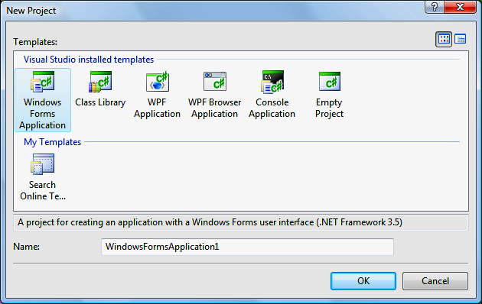
RECALL: 2.2 Overview of the Visual Studio 2008 IDE
The New Project dialog (Fig. 2.3) displays.
Templates are project types users can create in
Visual C#.
  A Windows Forms application executes within a Windows operating system and has a graphical user interface (GUI).
Visual C# Windows Forms Application (selected)
Default project name
(provided by Visual Studio)
Description of selected project (provided by Visual Studio)
Fig. 2.3 | New Project dialog.

Slide 63
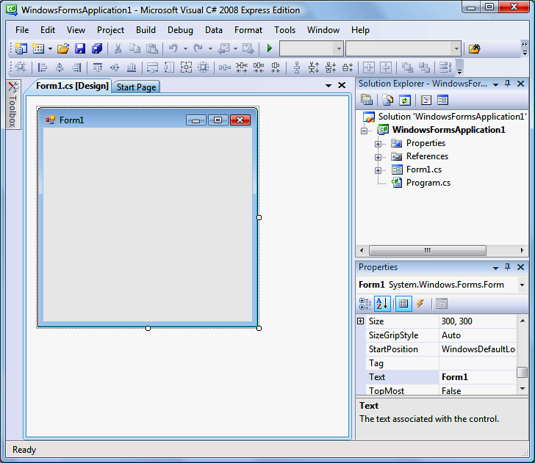
2.2 Overview of the Visual Studio 2008 IDE (Cont.)
Active tab
Tabs
Menu
Menu bar
Solution Explorer window
The gray rectangle (called a Form) represents the main window of the application.
Form (Windows Forms application)
Properties window
Fig. 2.4 | Design view of the IDE.

Slide 64
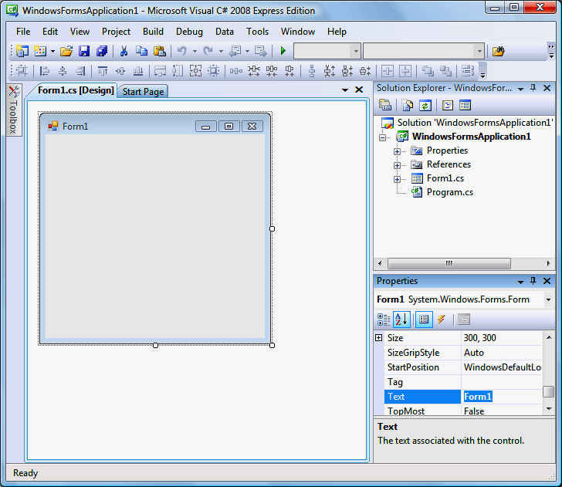
2.2 Overview of the Visual Studio 2008 IDE (Cont.)
Figure 2.5 shows where the Form’s name can be modified in the Properties window.
Text box (displaying the Form’s name,
Form1) which can be modified
Fig. 2.5 | Textbox control for modifying a property in the Visual Studio IDE.

Slide 65
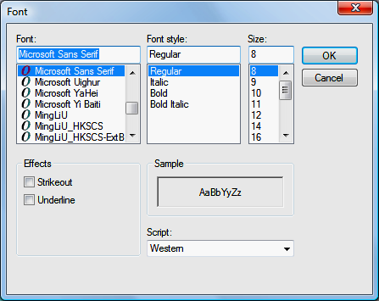
2.2 Overview of the Visual Studio 2008 IDE (Cont.)
Figure 2.6 shows a dialog in which a control’s font properties can be modified.
OK button
Cancel button
Fig. 2.6 | Dialog for modifying a control’s font properties in the Visual Studio IDE.

Slide 66
RECALL: 2.3 Menu Bar and Toolbar
Commands for managing the IDE are contained in menus on the menu bar of the IDE (Fig. 2.7).
The set of menus displayed depends on what you are currently doing in the IDE.
Menus contain groups of related menu items that cause the IDE to perform specific actions.
Fig. 2.7 | Visual Studio menu bar.

Slide 67
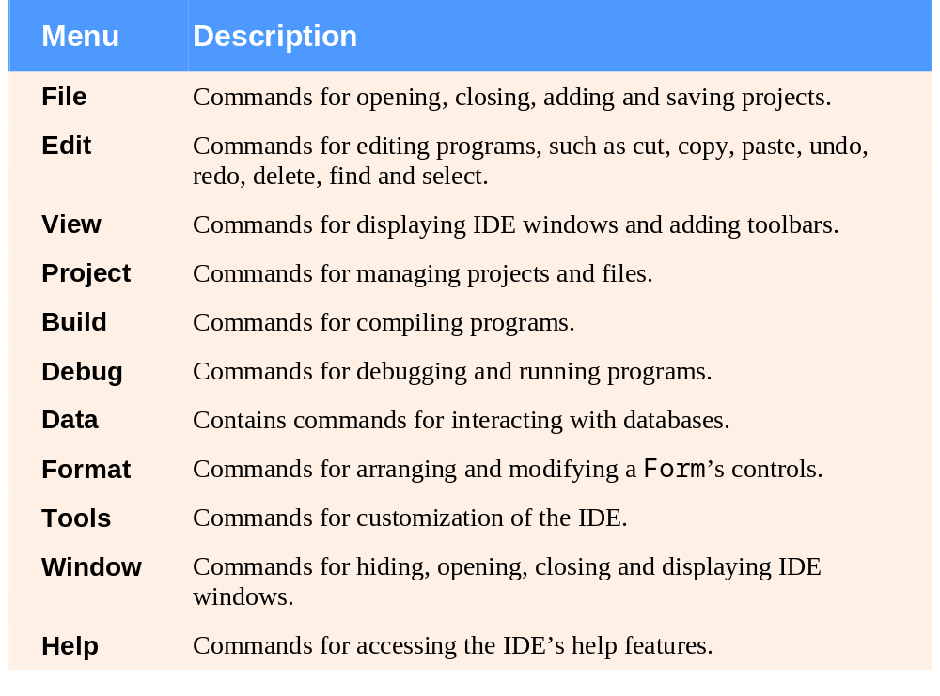
2.3 Menu Bar and Toolbar (Cont.)
Fig. 2.8 | Summary of Visual Studio 2008 IDE menus.

Slide 68
RECALL: 2.4 Navigating the Visual Studio IDE
The IDE provides windows for accessing project files and customizing controls.
These windows can be accessed via the toolbar icons (Fig. 2.13) or the View menu.
Properties window
Object
Browser
Solution
Explorer
Toolbox
Fig. 2.13 | Toolbar icons for Visual Studio windows.

Slide 69
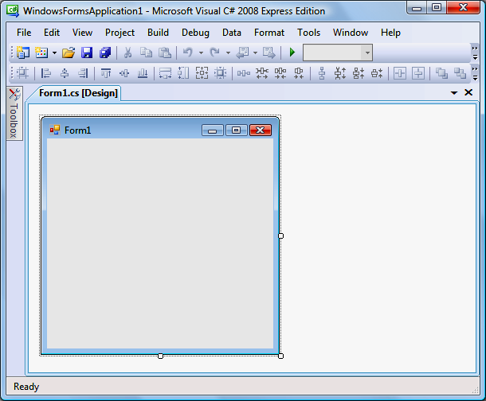
2.4 Navigating the Visual Studio IDE (Cont.)
When auto-hide is enabled, a tab appears along the edge of the IDE window (Fig. 2.14).
Icon for hidden window
(auto-hide enabled)
Fig. 2.14 | Auto-hide feature demonstration.

Slide 70
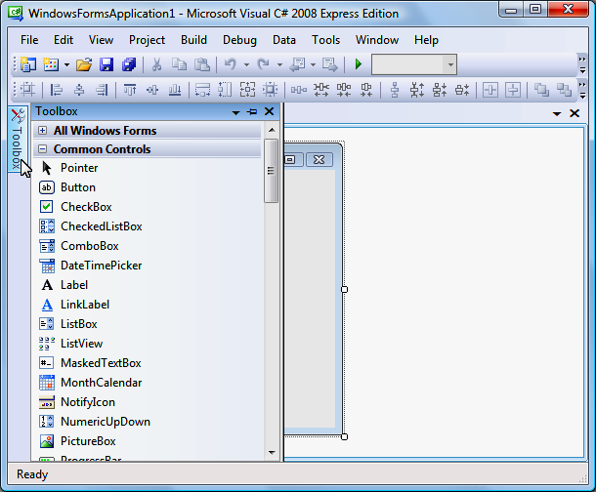
2.4 Navigating the Visual Studio IDE (Cont.)
Placing the mouse pointer over one of these icons displays that window (Fig. 2.15).
Horizontal orientation for pin icon when auto-hide is enabled
Toolbox title bar
Fig. 2.15 | Displaying a hidden window when auto-hide is enabled.

Slide 71
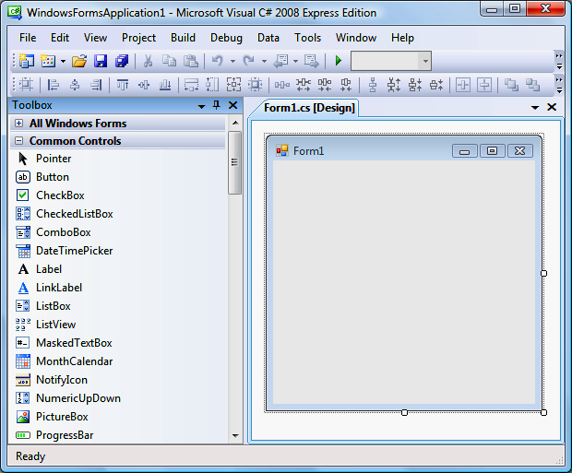
2.4 Navigating the Visual Studio IDE (Cont.)
To disable auto-hide and keep the window open, click the pin icon in the window’s upper-right corner.
When a window is “pinned down,” the pin icon is vertical (Fig. 2.16).
Toolbox “pinned down”
Vertical orientation for pin icon
when window is pinned down
Fig. 2.16 | Disabling auto-hide (“pinning down” a window).

Slide 72
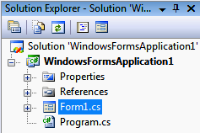
2.4 Navigating the Visual Studio IDE (Cont.)
2.4.1 Solution Explorer
The Solution Explorer window (Fig. 2.17) provides access to all of a solution’s files.
The solution’s startup project runs when you select Debug > Start Debugging.
The file that corresponds to the Form is named Form1.cs. Visual C# files use the .cs file-name extension.
Toolbar
Startup project
Show All Files icon
Fig. 2.17 | Solution Explorer with an open project.

Slide 73
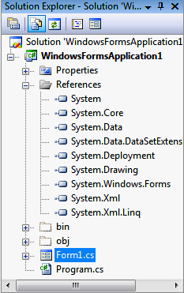
2.4 Navigating the Visual Studio IDE (Cont.)
Clicking the Show All Files icon displays all the files in the solution (Fig. 2.18).
Plus box
Minus box
Previously
hidden folders

Slide 74
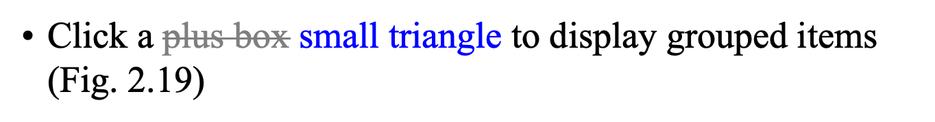
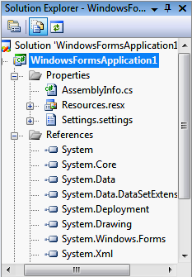
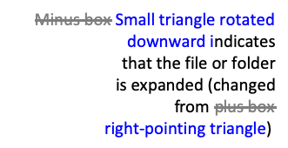
2.4 Navigating the Visual Studio IDE (Cont.)

Slide 75
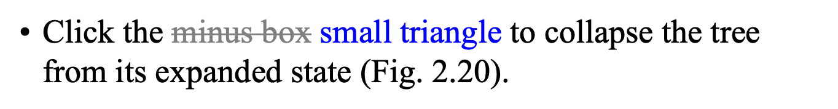
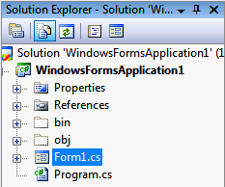
2.4 Navigating the Visual Studio IDE (Cont.)
Left-pointing small triangles indicate
that the file or folder
is collapsed (changed from
downward pointing small triangles
Fig. 2.20 | Solution Explorer collapsing all files after you click any small triangle.

Slide 76
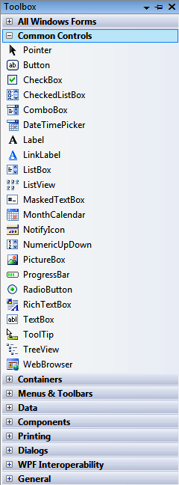
2.4 Navigating the Visual Studio IDE (Cont.)
2.4.2 Toolbox
The Toolbox contains icons representing controls used to customize Forms (Fig. 2.21).
The Toolbox groups the prebuilt controls into categories.
Controls
Group names
Fig. 2.21 | Toolbox window displaying controls for the Common Controls group.

Slide 77
2.4 Navigating the Visual Studio IDE (Cont.)
2.4.2 Toolbox
To display the Properties window, select View > Properties Window.
The Properties window allows you to modify a control’s properties visually, without writing code (Fig. 2.22).

Slide 78
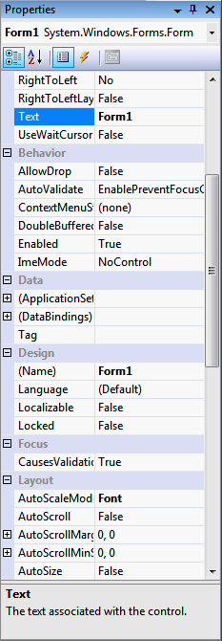
2.4 Navigating the Visual Studio IDE (Cont.)
Component
selection drop-down list
Categorized icon
Toolbar
Alphabetical icon
Scrollbox
Properties
Scrollbar
Property values
Description
Fig. 2.22 | Properties window showing the description of the selected property.

Slide 79
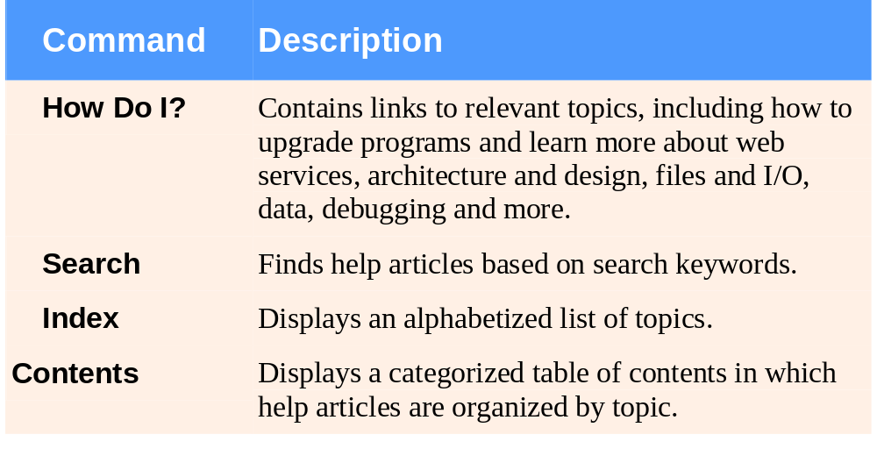
RECALL: 2.5 Using Help
The Help menu commands are summarized in Fig. 2.23.
Fig. 2.23 | Help menu commands.

Slide 80
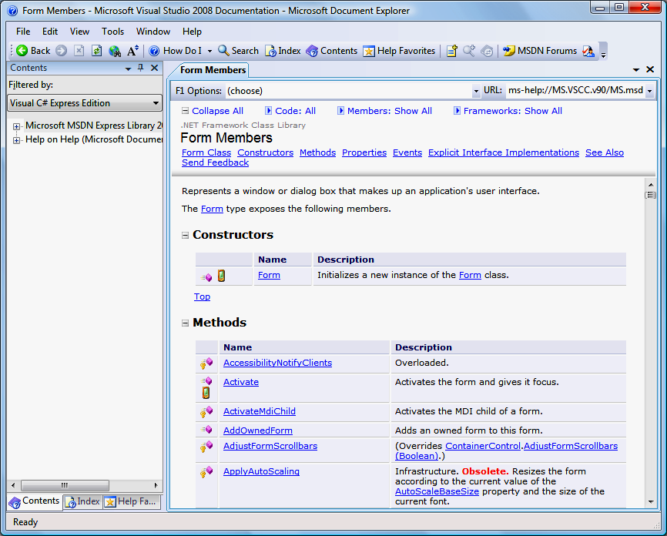
2.5 Using Help (Cont.)
Help in VS 2010 is a disaster!
  Microsoft should be ashamed of what they did. A huge step back compared to Help in VS 2008.
Context-sensitive help displays relevant help articles rather than a generalized list (Fig. 2.24).
  To use context-sensitive help, click an item, then press the F1 key.
This is how good it was in VS 2008:
Fig. 2.24 | Using context-sensitive help to show help articles related to a Form.

Slide 81
2.5 Using Help (Cont.)
Select Tools > Options…
  Make sure that the Show all settings checkbox is checked (Fig. 2.25).←from VS 2008
Select Help on the left, then locate the Show Help using: drop-down list.
  External Help Viewer displays articles in a separate window
  Integrated Help Viewer displays a help article inside the IDE.

Slide 82
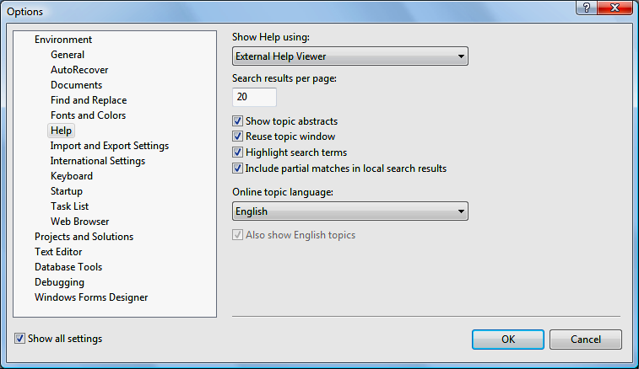
2.5 Using Help (Cont.)
Help options selected
Show Help using drop-down list
Show all settings check box
Fig. 2.25 | Options dialog displaying Help settings.

Slide 83
The End

